Slide 1
3. Transaction Concepts and concurrency control
2.1 Describe a transaction, properties of transaction, state of the transaction.
2.2 Executing transactions concurrently associated problem in concurrent
execution.
2.3 Schedules, types of schedules, concept of Serializability, Precedence graph for Serializability.
2.4 Ensuring Serializability by locks, different lock modes, 2PL and its variations.
2.5 Basic timestamp method for concurrency, Thomas Write Rule.
2.6 Locks with multiple granularity, dynamic database concurrency (Phantom Problem).
2.7 Timestamps versus locking.
2.8 Deadlock handling methods
2.8.1 Detection and Recovery (Wait for graph).
2.8.2 Prevention algorithms (Wound-wait, Wait-die)

Slide 2
2.1 Describe a transaction, properties of transaction, state of the transaction.
Transaction
A transaction is a unit of program execution that accesses and possibly updates Content of database(data items).

Slide 3
Example of Transaction
Let T_{i} be a transaction that transfer money from account A (5000) to account B. The transaction can be defined as
T₁: read (A) (read A)
A := A – 5000 (withdraw from A)
write (A); (update A)
read (B) (read B)
B := B + 5000 (deposit B)
write (B) (update B)
Example 1.1

Slide 4
Properties of transaction
Transaction should follow some properties to maintain integrity and quality of database.
ACID properties of transaction.
Atomicity
Consistency
Isolation
Durability

Slide 5
Need of atomicity
State before the execution of transaction T₁
The value of A = 500
The value of B = 100
T₁: read (A) 500
A := A – 100 400
write (A); 400
Failure occur
read (B)
B := B + 100
write (B)
State after the execution of transaction T₁ (inconsistent state)
The value of A = 400
The value of B = 100
T₁: read (A)
A := A – 100
write (A);
read (B)
B := B + 100
write (B)
State after the execution of transaction T₁ (consistent state)
The value of A = 400
The value of B = 200

Slide 6
Atomicity
It is Either preformed all operations of the transaction or not performed at all.
If a transaction begins to execute but fails for some reason, any changes to the database that the transaction may have made must be undone.
It is the responsibility of recovery manager of the DBMS to ensure atomicity.
Consistency
It is constraint satisfying property which takes the database from one consistent state to another .this property ensures that DBMS satisfies all constraints available in database.
It is the responsibility of the programmer who writes the database programs and enforces integrity constraints on the DBMS

Slide 7
Isolation
It is the non interference property .
Even if there are ‘n’ number of transactions running concurrently, they should be independent of each other i.e. they should not affect each other.
Even if one of the transaction aborts or rollbacks, it should not affect the other.
It is the responsibility of the concurrency control manager to ensure isolation and this is achieved by hiding the updates made by a transaction until it is committed
Isolation provides results of the concurrent transaction which are similar to serial schedule
Durability
This is the persistence property.
It says that changes made to the database by committed transaction should persist in the database ,these changes should not be lost due to any failure.
It is the responsibility of the recovery manger of the DBMS to ensure durability

Slide 8
States of transaction
Begin
Begin transaction
Start-to-commit
Commit
Committed
Active
Partially Committed
Error detected during
transaction
System Failure
Database Modified
Abort
Error
Rollback
Terminated
Consistent State
Database Unmodified

Slide 9
Log file in main memory
[ Start-transaction, T1]
[Write-item, T1, B, 10]
[Commit, T1]
[Start-transaction, T2]
[Write-item, T2, D, 20]
[Write-item, T2, A, 30]
[Commit, T2]
T1 | T2
B=10
WRITE(B)
COMMIT
 | D=20
 | WRITE(D)
 | A=30
 | WRITE(A)
 | COMMIT
Commit : All log records for committed transactions saved on hard disk.
Checkpoint : Database is updated according to all log records
LOG FILE in Secondary Storage
Database on Hard Disk
[Start-transaction, T1]
[Write-item, T1, B, 10]
[Commit, T1]
[Start-transaction, T2]
[Write-item, T2, D, 20]
[Write-item, T2, A, 30]
[Checkpoint]
[Commit, T2]
B=10

Slide 10
States of transaction
1. Begin : Transaction is said to in begin state when it executes BEGIN_TRANSCATION statement.
2. Active: Transaction enters into active state by executing its first read or write instruction.
3. commit: Transaction is said to be in partially committed state when it starts to transfer all updated values of data items on hard disk
4.Rollback: There is possibility that transaction may fail to complete all its operations because of some system failure or errors ,in this case to keep database in consistent state recovery manger has to undo all operations of transaction .This state of transaction is called rollback state.
5. End: Transaction can end in three different ways
- Successful termination :A transaction ends after completion of commit statement.
- Suicidal :A transaction detects an error(e.x. divide by zero error) during its processing and thus aborts and performs rollback operation
- Murderous termination : The operating system or DBMs can force the transaction to be aborted for any reason

Slide 11
Conflict operations in concurrent transaction
In case of concurrent transactions, the chances of conflict between the operations of various transactions are much . The operations are said to be conflict if
They belong to different transactions
They access same data item ‘a’
At least one of the operation is WRITE
RW – conflict : If the write set of one transaction intersects with the read set of another.
WW – conflict : If the write set of one transaction intersects with the write set of another.
Problems caused by conflict operations in concurrent transactions
Lost update problem
This problem is caused due to concurrent modification of the same data item.
This type of problem occurs when two transaction access same data item and the operations of these transactions interrupt each other in such way that it results in the incorrect value of that data item.

Slide 12
Example:
A=100
T1 :
T2 :
READ (A)
A:= A-10 90
READ (A)
A:= A+10
WRITE(A)
A=90 (DB)
WRITE(A)
If we execute above transaction by assuming A=100
In an serial schedule ,where transaction T1 is performed completely first and then T2 ,the correct final value of A will be 100
Execution of above concurrent transaction will generate incorrect value of A(A=110) because its update by T1 is lost .

Slide 13
2. Temporary update or dirty read problem
This problem is caused when one transaction modifies a data item while it is being used by other transaction.
This type of problem occurs when one transaction updates a data item and then for some reason ,the transaction fails before commit. The updated item is accessed by another transaction before its is changed back to its original value.
Example

Slide 14
Example of dirty read problem
A=100
T1 :
T2 :
READ (A) 100
A:= A-50
Write (A) 50
T1 fails and before it sets the value of ‘A’ back to its original value ;T2 reads temporary updated value of A
READ (A) 50
A:= A+10 60
Write(A) 60
Abort
Read(B)

Slide 15
3. Unrepeatable read problem
When a transaction T1 reads a data item twice and another transaction changes the value of that data item in between those two read operations, then T1 reads different values for its two read operations of the same item

Slide 16
Example of Unrepeatable read problem
T1 :
T2 :
READ (A)
Consider there are 100 rupees in account ‘A’ .
The customer comes and checks his account ,reads 100 rupees in the account.
Then he decided to withdraw the whole amount as he access the account ‘A’ once again to withdraw the money , he sees only 10 rupees left
Because in the mean time 90 rupees were transferred to account B by transaction T2.
Thus the same customer reads different values of the same account (A) for two read operations.
This shows that values are not same for two reads
READ (A)
A:= A-90
Write(A)
READ(B)
B:=B+90
WRITE(B)
A:= A-100
Write (A)

Slide 17
3. Incorrect summary problem
Assume one transaction is calculating the aggregate summary of some data items in the meanwhile other transaction is updating some of theses data items .
In this case aggregate function uses some values after they are updated and some before they are updated producing incorrect summary of records, this problem is termed as incorrect summary problem

Slide 18
Example of incorrect summary problem
T1 :
T2 :
sum:=0
To perform addition of A,B and C T2 is using
Value of A after updation and
Value of B and C before updation
Thus incorrect sum is produced
READ (A)
A:= A+50
Write(A)
READ(A)
sum:=sum+A
READ(B)
sum:=sum+B
READ(C)
Sum:=sum+C write(sum)
READ (B)
B:= B+50
Write(B)
READ (C)
C:= C+50
Write(C)

Slide 19
Schedule
Schedule is an interleaving of actions from a set of transactions ,where the actions of any one transactions are in the original order.
Schedule is decided by database scheduler who receives stream of user requests that arise from the active transactions.
Schedule can be represented in the form of notations as :
S: R1(a); R2(a); W1(a); R1(b); W2(a); W1(b);
R1(a)- read operation of transaction 1on data item a.

Slide 20
Example:
A=100
T1 :
T2 :
T1 :
T2 :
READ (A)
A:= A-10 90
READ (A)
A:= A+10
t1
READ (A)
A:= A-10
WRITE(A)
A=90 (DB)
WRITE(A)
WRITE(A)
A=90
t4
READ (A)
A:= A+10
t7
WRITE(A)

Slide 22
Example of schedule

Slide 23
Types of schedules based on order of operations
Serial Schedule
All the transactions in a schedule are performed one by one
If there are two transactions T1 and T2 ,execute all the operations of T1 in the sequence followed by all the operations of T2 in the sequence or vice versa
Only one transaction is active at a time
The commit of one transaction initiates the execution of the next transaction.
Interleave of operations doesn't occur in serial schedule.
Thus transaction in serial schedule can not share CPU and disk operations at a time, it decreases system throughput.
Example: in notebook

Slide 25
Example of serial schedule
T1 :
T2 :
READ (A)
A:= A-90
Write(A)
READ(B)
B:=B+90
WRITE(B)
commit
READ (A)
A:= A-100
Write (A)
commit

Slide 26
Non-serial schedule
In this schedule ,the execution order of operations in transactions and the execution order of transactions are unpredictable.
Operations from set of concurrent transactions are interleaved.
Thus transaction in non-serial schedule can share CPU and disk operations at a time thus ,it increases system throughput.
Example: in notebook

Slide 27
Example of non-serial schedule
T1 ,T2,T3
<T1,T2,T3>
<T2,T1,T3>
<T3,T2,T1>
R1(a); R2(a);W1(a);R1(b);W2(a);C2;W1(b);C1
T1 :
T2 :
READ (A)
READ (A)
A:= A-90
Write(A)
READ(B)
B:=B+90
WRITE(B)
COMMIT
A:= A-100
Write (A)
COMMIT

Slide 28
Example
Concept of recoverable schedule
T1 :
T2 :
READ (A)
A:= A-10
WRITE(A)
READ(A)
A=A+10
WRITE(A)
COMMITT
COMMITT

Slide 29
Types of schedules based on recoverability
Recoverable schedule
Recoverable schedule is one in which transactions commit only after all transactions whose changes they read commit.
If transaction Tj reads a data items previously written by a transaction Ti the commit operation of Ti appears before the commit operation of Tj.
T1 T2

Slide 30
Example
The following schedule is not recoverable if T2 commits immediately after updation of value of A
T1 :
Log file
T2 :
Database
A=100
READ (A) 100
A:= A-10 90
WRITE(A) 90
COMMITT
A=100
READ(A) 90
A=A+10 100
WRITE(A) 100
COMMIT

Slide 31
Find out recoverable schedules from below given schedules
S1 : R1(a); R2(a);W1(a);R1(b);W2(a);C2;W1(b);C1
S2: R1(a);W1(a);R2(a);R1(b);W2(a);C2;A1
T1 T2
read(a)
write(a)
read(a)
read (b)
write(a)
commit
Abort

Slide 32
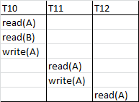
Cascading rollback concept
Transaction T10 writes a value of A that is read by Transaction T11. Transaction T11 writes a value of A that is read by Transaction T12. Suppose at this point T10 fails. T10 must be rolled back, since T11 is dependent on T10, T11 must be rolled back, T12 is dependent on T11, T12 must be rolled back.
This phenomenon, in which a single transaction failure leads to a series of transaction rollbacks is called Cascading rollback.

Slide 33
2. Cascade less schedule
Cascade less schedule is one in which every transaction in the schedule reads only the data items that were written by committed transactions .
It is recoverable and it avoids cascading rollbacks
Example
T1 :
T2 :
READ (A)
A:= A-10
WRITE(A)
READ(B)
WRITE(B) COMMIT
READ(A)
WRITE(A)
COMMIT

Slide 34
Check given schedules are cascade less or not if not convert them to cascadeless schedule
S1 : R1(a); R2(a);W1(a);R1(b);W2(a);C2;W1(b);C1
T1 T2
read(a)
write(a)
commit
read(a)
write(a)
commit
S2: R1(a);W1(a);R2(a);R1(b);W2(a);C2;A1
Schedule :R1(A);W1(A);R2(Z);W2(Z);R1(B);W1(B);R2(B);W2(B);C1;C2

Slide 35
3. Strict Schedule
Strict schedule Is one in which transactions can neither read nor write the item ‘a’ until the last transaction that wrote ‘a’ has committed(or aborted) .
Strict schedules can be recovered.

Slide 36
Serial schedule - T1,T2 - isolation –consistent data/correct data
systems speed will be less, you can execute less number of transactions for a given time
Non serial schedule : T1,T2 no isolation – may get incorrect data – system speed is high
Correct data + high system speed Non serial schedules which are equivalent to serial schedule

Slide 37
Serializibilty
A schedule S of n transactions is serializable schedule only if it is equivalent to some serial schedule of same n transactions .
serial non serial
Objective of serializibility
Objective of serializibilty is to find non-serial schedule that allow transactions to execute concurrently without interfering with one another.
Serializibilty is defined in terms of conflict serialzibilty and view serializibility

Slide 38
Conflict Operations
Instructions l1 and l 2 of transactions T1 and T2 respectively, conflict if and only if there exists some item Q accessed by both l1 and l2 , and at least one of these instructions wrote Q.
l1 = read(Q), l2 = read(Q). l1 and l2 don’t conflict
l 1 = read(Q), l2 = write(Q). They conflict
l 1 = write(Q), l2 = read(Q). They conflict
l 1 = write(Q), l2 = write(Q). They conflict

Slide 39
Conflict equivalent schedule
Two schedules S and S’ are conflict equivalent if
Order of conflict operations in S is similar to order of conflict operations in S’
S can be transformed into a schedule S’ by series of swapping of non conflicting instructions.
The order of any two conflicting operations is same in both schedules.
Non Conflict equivalent schedule
The order of the conflicting operations is different in both the schedules ,the effect can be different on the database or another transactions in schedule .Thus the schedules are non-conflict.

Slide 40
Conflict serializable
Definition: A given non-serial schedule is conflict equivalent to a serial schedule then it is conflict serializable.
How to find out non-serial schedule that are conflict equivalent to serial schedule
Assume a schedule S which there are two instructions I1 and I2 of transactions T1 and T2 respectively, use following steps to get equivalent non-serial schedule
If I1 and I2 refer to different data items ,then they are called as non-conflicting instructions and we can swap I1 and I2 .
If I1 and I2 refer to same data items ,they are called as conflicting instructions and there are four cases to be considered
I1= READ(a) and I2=READ(a) : The order of I1 and I2 does not matter
I1= READ(a) and I2=WRITE(a): The order of I1 and I2 does matter
I1= WRITE(a) and I2=READ(a): The order of I1 and I2 does matter
I1= WRITE(a) and I2=WRITE(a):The order of I1 and I2 does matter

Slide 41
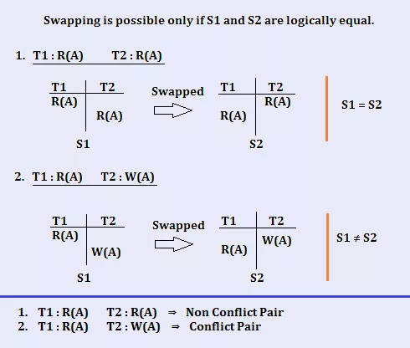
Example

Slide 42
T1 | T2
READ(A) | READ(C)
A=A-10 | C=C+10
WRITE(A) | WRITE(C)
READ(B) | READ(B)
B=B+10 | B=B+10
WRITE(B) | WRITE(B)
Give any 2 non-serial schedules serializable to serial schedule <T1, T2>

Slide 43
T1 | T2
READ(A)
A=A-10
WRITE(A)
READ(B)
B=B+10
WRITE(B)
 | READ(C)
 | C=C+10
 | WRITE(C)
 | READ(B)
 | B=B+10
 | WRITE(B)
T1 | T2
 | READ (C)
READ(A)
A=A-10
WRITE (A)
 | C=C+10
 | WRITE(C)
READ(B)
B=B+10
WRITE(B)
 | READ(B)
 | B=B+10
 | WRITE(B)
Schedule 1
Schedule 2
Conflict equivalent – order of conflict operations is same in both schedules . Schedule s1 and s2 are conflict equivalent
View equivalent

Slide 44
T1 | T2
READ(A)
A=A-10
WRITE(A)
READ(B)
B=B+10
WRITE(B)
 | READ(C)
 | C=C+10
 | WRITE(C)
 | READ(B)
 | B=B+10
 | WRITE(B)
T1 | T2
 | READ(C)
 | C=C+10
READ(A)
A=A-10
 | WRITE(C)
WRITE(A)
READ(B)
B=B+10
WRITE(B)
 | READ(B)
 | B=B+10
 | WRITE(B)
Conflict operations
1. If Ti reads the initial value of object A in S1, it must also read the initial value of A in S2.
2. If Ti reads a value of A written by Tj in S1, it must also read the value of A written by Tj in S2.
3. For each data object A, the transaction (if any) that performs the final write on A in S1 must also perform the final write on A in S2. (Schedule 1 and schedule 2 are view equivalent)

Slide 45
T1 | T2
READ(X)
X=X+10
WRITE(X)
 | READ(Z)
 | Z=z+10
 | WRITE(Z)
 | READ(X)
 | X=x+10
 | WRITE(X)
T1 | T2
READ(X)
 | READ(Z)
 | Z=Z+10
X=X+10
 | WRITE(Z)
WRITE(X)
 | READ(X)
 | X=X+10
 | WRITE(X)
Give any 2 non-serial schedules serializable to serial schedule <T1, T2>

Slide 46
T1 | T2
READ(X)
X=X+10
WRITE(X)
 | READ(Z)
 | Z=z+10
 | WRITE(Z)
 | READ(X)
 | X=x+10
 | WRITE(X)
T1 | T2
READ(X)
 | READ(Z)
 | Z=Z+10
X=X+10
 | WRITE(Z)
WRITE(X)
 | READ(X)
 | X=X+10
 | WRITE(X)
Give any 2 non-serial schedules serializable to serial schedule <T1, T2>

Slide 47
T1 | T2
READ(X)
X=X+10
WRITE(X)
 | READ(Z)
 | Z=z+10
 | WRITE(Z)
 | READ(X)
 | X=x+10
 | WRITE(X)
T1 | T2
 | READ(Z)
 | Z=Z+10
READ(X)
 | WRITE(Z)
X=X+10
WRITE(X)
 | READ(X)
 | X=X+10
 | WRITE(X)
Give any 2 non-serial schedules serializable to serial schedule <T1, T2>

Slide 48
Examples
Consider the following transaction :
T1 : T2 : T3 :
READ(X) READ(X) READ(Z)
READ(Y) READ(Z) READ(Y)
Y = Y – X X = N+Z Y= Y + Z
WRITE (Y) WRITE(X) WRITE (Z)
WRITE (X) WRITE (Y)
Give at least two non-serial schedules that are serializable.
Example: in notebook

Slide 50
Two schedules S1 and S2 of same transactions are view equivalent under following conditions
1. If Ti reads the initial value of object A in S1, it must also read the initial value of A in S2.
2. If Ti reads a value of A written by Tj in S1, it must also read the value of A written by Tj in S2.
3. For each data object A, the transaction (if any) that performs the final write on A in S1 must also perform the final write on A in S2.
View serializable
Definition: A schedule is view serializable if it is view equivalent to some serial schedule.
View equivalent schedule

Slide 51
T1
T2
A=100
Provide isolation of T1 and T2
a) Lock
T1 wants to use A= 100
- request lock to lock manager
- lock manager will check availability of lock on A
- if it available lock will be given to T1
- T1 will lock the data value A=100
- T1 will use value of A , if T2 request lock
- After its use T1 will release the lock

Slide 52
Concurrency control mechanisms
one of the fundamental properties of a transaction is isolation.
Isolation property states that every transaction in system must execute independent of all another transactions in system.
The database system must control concurrent execution of transactions to ensure that database state remains consistent.
If two transactions are accessing same value at the same time it may lead to inconsistent data
Concurrency control mechanism will allow to control concurrent access of multiple transactions to same data value
Concurrency control can be achieved using two mechanisms
1) Using lock based protocols
2) Using Time-stamps technique

Slide 53
Problem occurred in concurrent transactions
Example:
T1 T2
read(B) 200
B := B − 50 150
write(B) B=150
read(A) 100
read(B) 150
display(A + B) 250
read(A) 100
A := A + 50 150
write(A) A=150
Figure 15.4 Schedule 1.
Consider A=100 and B=200
Result of serial execution:
A+B=300
Result of concurrent execution without locking :
A+B=250 (incorrect result)

Slide 54
1) Ensuring Serializability by locks
One way to ensure isolation is to require that data items be accessed in a mutually exclusive manner; that is, while one transaction is accessing a data item, no other transaction can modify that data item.
The most common method used to implement this requirement is to allow a transaction to access a data item only if it is currently holding a lock on that item.
Lock is a variable associated with each data item and manipulating the value of that lock is called locking.
Locking the item used by transaction can prevent the other concurrently transactions from using this locked item Locking is done by lock manager of DBMS

Slide 55
Types of locks used in Locking
Binary Locks
It is a variable associated with each database item ‘X’ and has two states locked or unlocked(i.e. 1 or 0 ).
The operation LOCK_ITEM(X) is used by the transaction to lock the data item ‘ x’
If the ‘X’ is already used by some other transaction then value of lock for ‘x’ is 1.
Now you perform the operation LOCK_ITEM(X) then this operation fails and it is forced to wait until the lock is released.
LOCK_ITEM(X) =1 : data item x is locked
LOCK_ITEM(X) =0 : data item x is unlocked
Drawback :
Simultaneous reads of various transactions on same data item is not allowed.

Slide 56
2) Shared and exclusive locks
The drawback of binary lock is eliminated here. that is two transaction can perform read on same data item.
Shared lock(S)/read lock
If transaction wants to lock data item ‘x’ only for reading purpose it can request shared lock using LOCK_S(x) .
Multiple transactions can have shared lock on same data item at the same time.
It is also called as ‘Read Lock’
LOCK_S(x) LOCK_S(x) - non conflict operations ,lock will be given
LOCK_X(x) LOCK_S(x) - conflict operation, lock will not given for second transaction
LOCK_S(x) LOCK_X(x)- conflict , lock will not given for second transaction
LOCK_X(x) LOCK_X(x) -conflict , lock will not given for second transaction

Slide 57
ii)Exclusive Lock (X)/write lock/update lock
If transaction wants to read and write data item ‘x’,it can request exclusive lock using LOCK_X(x).
Multiple transactions can not have exclusive lock on same data item at the same time.
It is also called as ‘Write Lock’ or ‘Update Lock’
iii)Intention Lock
This is generally done by DBA in a situation where the portion of database is made completely unavailable for the rest of the users. this is done for an emergency recovery or backup of the database.

Slide 58
Steps to execute transactions using locking
To access data item transaction first request lock to the concurrency-control manager(lock manager).
Lock manager checks availability of lock by using lock compatibility matrix
After getting lock on data item from lock manager transaction can access data item

Slide 59
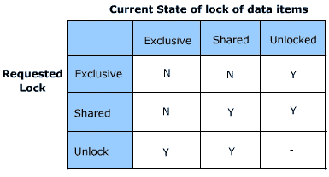
Lock Matrix

Slide 60
Problem occurred in locking mechanism
Example:
T1 T2 concurrency-control manager
lock-X(B)
grant-X(B, T1)
read(B)
B := B − 50
write(B)
unlock(B)
lock-S(A)
grant-S(A, T2)
read(A)
unlock(A)
lock-S(B)
grant-S(B, T2)
read(B)
unlock(B)
display(A + B)
lock-X(A)
grant-X(A, T1)
read(A)
A := A + 50
write(A)
unlock(A)
Figure 15.4 Schedule 1.
Consider A=100 and B=200
Result of serial execution:
A+B=300
Result of concurrent execution using locking :
A+B=250 (incorrect result)
Though we are suing locking mechanism concurrent schedule may give incorrect values)

Slide 61
Reason for getting incorrect results for above schedule is:
The transaction T1 unlocked data item B too early, as a result of which T2 saw an inconsistent state.
How we can avoid it:
We can postpone unlock(B)(i.e. unlocking of B) so that T2 will not see inconsistent state of B.

Slide 62
Problem occurred if transaction postpone unlock at the end of its execution
Example:
T1 T2 concurrency-control manager
lock-X(B) grant-X(B, T1)
read(B)
B := B − 50
write(B)
lock-S(A)
grant-S(A, T2)
read(A)
lock-S(B)
wait for unlock(B) by T1
read(B)
display(A + B)
unlock(A)
unlock(B)
lock-X(A)
wait for unlock(A) by T2 T1 : A and Lock B
T2 : Lock A and B
read(A)
A := A + 50
write(A)
unlock(A)
unlock(B)
Figure 15.4 Schedule 1.
In this schedule no any transaction is able to complete its execution :
T1 is waiting for T2 and
T2 is waiting for T1
It causes deadlock.
A=100(T2 lock)
B=200 (T1 lock)

Slide 63
If we do not use locking, or if we unlock data items too soon after reading or writing them, we may get inconsistent states.
On the other hand, if we do not unlock a data item before requesting a lock on another data item, deadlocks may occur.
Deadlocks are definitely preferable to inconsistent states, since they can be handled by rolling back transactions, whereas inconsistent states may lead to real-world problems that cannot be handled by the database system.
While using locking ,there is need of some set of rules to indicate when transaction should lock and unlock data item, those rules are nothing but locking protocols.

Slide 64
Two phase locking protocol (2PL)
Two guide when to lock or unlock data items 2PL is used
Working of 2PL
2PL divides transaction in to two phases
Growing phase
In this phase transaction may issue locks but does not release any lock
Transaction can
-Acquire LOCK_S on data item ,
-Acquire LOCK_X on data item
-Can convert LOCK_S to LOCK_X (Upgrade)

Slide 65
b) Shrinking Phase
In this phase transaction may release locks, but does not issue any locks.
When a transaction release a lock, it enters into the shrinking phase and can issue no more locks.
Transaction can
-Release UNLOCK_S on data item
- Release UNLOCK_X on data item
-Can convert LOCK_X to LOCK_S (downgrade)
T1 : LOCK_S(A) LOCK_X(B) LOCK_S(C) UNLOCK(A) UNLOCK(B) UNLOCK(C) LOCK(D)
T2: LOCK_S(P) LOCK_X(Q) LOCK_S(Z) LOCK_X(P) LOCK_S(P) UNLOCK(P) UNLOCK(Q) UNLICK(z)

Slide 66
Important points about 2PL
Schedules given by 2Pl are conflict serilalizable.
Cascading rollback may occur under 2PL(i.e. may not Provide cascadeless schedules)
2PL does not ensure freedom from deadlock

Slide 67
Variations of 2PL
Strict two phase locking protocol (strict 2PL)
Cascading rollbacks in 2PL can be avoided by a modification of two-phase locking called the strict two-phase locking protocol.
This protocol requires not only that locking be in two phase, but also that all exclusive-mode locks taken by a transaction be held until that transaction commits.
This requirement ensures that any data written by an uncommitted transaction are locked in exclusive mode until the transaction commits, preventing any other transaction from reading the data. And hence avoids cascading rollbacks

Slide 68
Important points about strict 2PL
Schedules given by 2Pl are conflict serilalizable.
Cascading rollback not occur under2PL(i.e. Provides cascade less schedules)
Strict 2PL does not ensure freedom from deadlock

Slide 69
Variations of 2PL continued…..
2) Conservative two phase locking protocol (Conservative 2PL)
Deadlock in strict 2PL can be avoided by a modification of strict two-phase locking protocol called the conservative two-phase locking protocol.
This protocol requires that all locks be held until the transaction commits.
This requirement ensures deadlock free schedules

Slide 70
Important points about conservative 2PL
Schedules given by 2Pl are conflict serilalizable.
Cascading rollback not occur under2PL(i.e. Provides cascade less schedules)
conservative 2PL ensures freedom from deadlock

Slide 71
Assignment
1.Define transaction
2.State desirable properties of transaction .
3.List conflict operations
4.List problems occurred in concurrent execution
5. Define serializibilty

Slide 72
What is timestamp and how it is allocated to transactions and data values
Unique time value is assigned to every transaction as soon as transaction starts its execution. To determine the timestamp of the transaction, this protocol uses system time or logical counter.
Ex. At time 1 T1 started its execution the time stamp of T1 is 1 T1 – timestamp 1
At time 2 T2 started its execution the time stamp of T1 is 2 T2- timestamp 2
T3 – timestamp 3
Also two timestamps are associated with every data value Q
W-timestamp(Q) – denotes largest timestamp of any transaction that executed WRITE(Q) operation successfully.
R-timestamp(Q) – denotes largest timestamp of any transaction that executed READ(Q) operation successfully.
Theses timestamps are updated whenever a new WRITE(Q) and READ(Q) Operations are executed

Slide 73
T1 2
T2 3
T3 4
W(Q ) 1
R(Q) 3
T1 is requesting W(Q) : max(2,1) = 2 ,W(Q)=2
T2 is READ(Q) : max(3,3) : R(Q)=3
2>1 allowed R(Q) =max(1,2) =2

Slide 74
The Timestamp-Ordering Protocol
The timestamp-ordering protocol ensures that any conflicting read and write operations are executed in timestamp order. This protocol operates as follows:
1. Suppose that transaction Ti issues read(Q).
If TS(Ti ) < W-timestamp(Q), then Ti needs to read a value of Q that was already overwritten. Hence, the read operation is rejected, and Ti is rolled back.
b. If TS(Ti ) ≥ W-timestamp(Q), then the read operation is executed, and R-timestamp(Q) is set to the maximum of R-timestamp(Q) and TS(Ti ).

Slide 75
2. Suppose that transaction Ti issues write(Q).
a. If TS(Ti ) < R-timestamp(Q), then the value of Q that Ti is producing was needed previously, and the system assumed that that value would never be produced. Hence, the system rejects the write operation and rolls Ti back.
b. If TS(Ti ) < W-timestamp(Q), the system rejects this write operation and rolls Ti back.
c. Otherwise, the system executes the write operation and sets W-timestamp(Q) to TS(Ti ).

Slide 77
Thomas write rule
Thomas write rule says that write operation by older transaction (Ti) is ignored rather than rejected and rollback of Ti.
As value produced by older transaction is one that will never need to be read.
Modification to the timestamp-ordering protocol, called Thomas’ write
rule, in this, Suppose that transaction Ti issues write(Q).
1. If TS(Ti ) < R-timestamp(Q), then the value of Q that Ti is producing was previously needed, and it had been assumed that the value would never be produced. Hence, the system rejects the write operation and rolls Ti back.
2. If TS(Ti ) < W-timestamp(Q),this write operation can be ignored.
3. Otherwise, the system executes the write operation and sets W-timestamp(Q) to TS(Ti ).

Slide 78
Multiple granularity
While using lock based protocols we consider individual data items of database.
If there transactions Ti needs access whole database then it will be time consuming to lock all individual data items.
It would be better if Ti could issue a single lock request to lock the entire database.
On the other hand, if transaction Tj needs to access only a few data items, it should not be required to lock the entire database, since otherwise concurrency is lost.
Multiple granularity protocol allow the system to define multiple levels of granularity.
This is done by allowing data items to be of various sizes and defining a hierarchy of data granularities, where the small granularities are nested within larger ones.

Slide 79
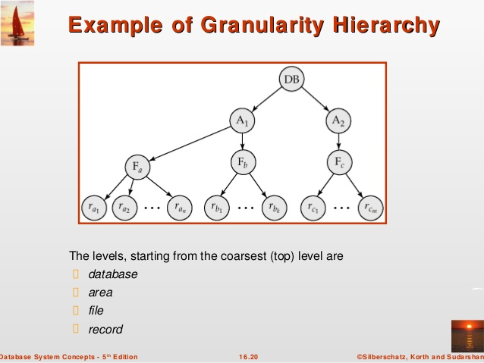

Slide 80
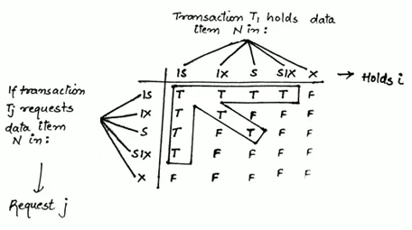
Locking at granularity levels
Locks used at granularity levels are
Intention-shared (IS) indicates that an shared lock will be requested on some lower node.
Intention-exclusive (IX) indicates that an exclusive lock will be requested on some lower node.
Shared-Intention-Exclusive(SIX) indicates that the current node is locked in shared mode but an exclusive lock will be requested on some lower node.
Locks will granted to requesting transactions according to Compatibility matrix.

Slide 81
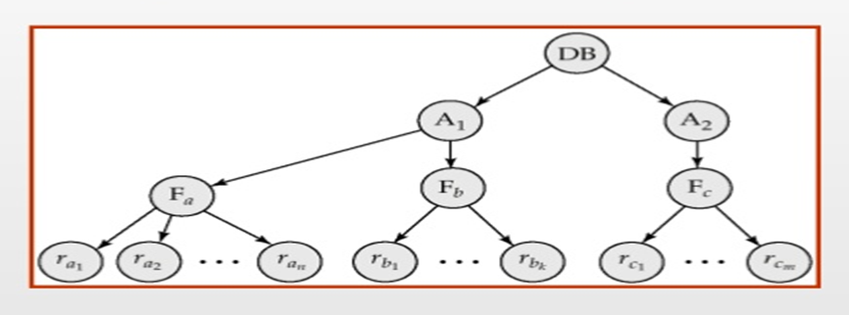
Multiple granularity protocol
The multiple-granularity locking protocol uses IS,IX and SIX lock modes to ensure serializability.
It requires that a transaction Ti that attempts to lock a node Q must follow these rules:
1. Transaction Ti must observe the lock-compatibility matrix to grant locks .
2. Transaction Ti must lock the root of the tree first, and can lock it in any mode.
3. Transaction Ti can lock a node Q in S or IS mode only if Ti currently has the parent of Q locked in either IX or IS mode.
4. Transaction Ti can lock a node Q in X, SIX, or IX mode only if Ti currently has the parent of Q locked in either IX or SIX mode.
5. Transaction Ti can lock a node only if Ti has not previously unlocked any node (that is, Ti is two phase).
6. Transaction Ti can unlock a node Q only if Ti currently has none of the children of Q locked.

Slide 82
dynamic database concurrency (Phantom Problem).
In dynamic database If the collection of database objects is not fixed, but can grow and shrink through the
insertion and deletion of objects. In dynamic database we face Phantom Problem.
Phantom Problem
Consider transaction T1 is calculating sum of salary of all employees of computer department
as select sum (salary) from employee where dname=‘computer’;
To do this T1 locks records of all employees of computer department to perform sum of salary.
Consider another transaction T2 inserts one record in employee table for computer department as
insert into employee values(101,’abc’, 50000, ‘computer’);
Though T1 has locked records of all employees of computer department to perform sum of salary,T1 is not aware of new inserted record by T2.
Hence T1 and T2 do not access any common tuple yet they conflict with each other because of insertion of new record it is called Phantom Problem.
employee 5 employees T1 sum(salary) from employee ; lock (5 records of employee) T2 insert one record employee dynamic databases

Slide 83
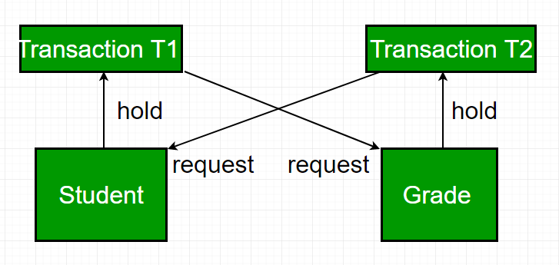
Deadlock in Database
In a database, a deadlock is an unwanted situation in which two or more transactions are waiting indefinitely for one another to give up locks.

Slide 84
Deadlock prevention – For large database, deadlock prevention method is suitable. A deadlock can be prevented if the resources are allocated in such a way that deadlock never occur.
Deadlock prevention mechanism
Wait-Die Scheme
If a transaction request for a resource that is locked by other transaction, then the DBMS simply checks the timestamp of both transactions and allows the older transaction to wait until the resource is available for execution.
If the older transaction has held some resource and younger transaction waits for the resource, then younger transaction is killed and restarted with minute delay with same timestamp.

Slide 85
Example (Wait-die)
T1(older) is requesting lock hold by T2(younger)
if TS (T1) < TS (T2) – if T1 is the older transaction and T2 has held some resource, then it allows T1 to wait until resource is available for execution.
T2(younger) is requesting lock hold by T1(older)
if TS (T1) < TS (T2) – if T1 is the older transaction and T1 has held some resource, then T2 is killed and restarted with minute delay with same timestamp.

Slide 86
Wound Wait Scheme
In this scheme, if an older transaction requests for a resource held by younger transaction, then older transaction forces younger transaction to kill the transaction and release the resource.
If the younger transaction is requesting a resource which is held by older one, then younger transaction is asked to wait till older releases it.

Slide 87
Example (Wound –wait)
Older – high
Younger – low
T1 is requesting lock hold by T2
if TS (T1) < TS (T2) – if T1 is the older transaction and T2 has held some resource, then T1 forces T2 to kill the transaction and release the resource.
T2 is requesting lock hold by T1
if TS (T1) < TS (T2) – if T1 is the older transaction and T1 has held some resource, then T2 forces T2 is asked to wait till older releases it.

